Slide 1
MARKETING AND RETAIL ANALYTICS
By – Subhransu Pradhan

Slide 2
OBJECTIVE
To identify top products that contribute to the revenue.
Analyze the customer purchase behaviour to estimate what items are more likely to be purchased individually or in combination with some other products.
Provide recommendations for better inventory management so as to reduce any unnecessary costs.

Slide 3
Data Exploration Data Cleaning Using Jupyter Notebook

Slide 4
Filter only records containing order_status = ‘delivered’ in the ‘orders’ table.
Treat missing values in the ‘order_approved_at’ and ‘order_delivered_timestamp’ columns of the ‘orders’ table.
order_approved_at = order_purchase_timestamp in case the former is null.
order_delivered_timestamp = order_estimated_delivery_date in case the former is null.
Remove duplicates at ‘customer_id’ level in the ‘customers’ table.
Clean the ‘product_weight_g’ column in the ‘products’ table for missing and null values.

Slide 5
DATA VISUALISATION Visualising Data Using Tableau

Slide 6
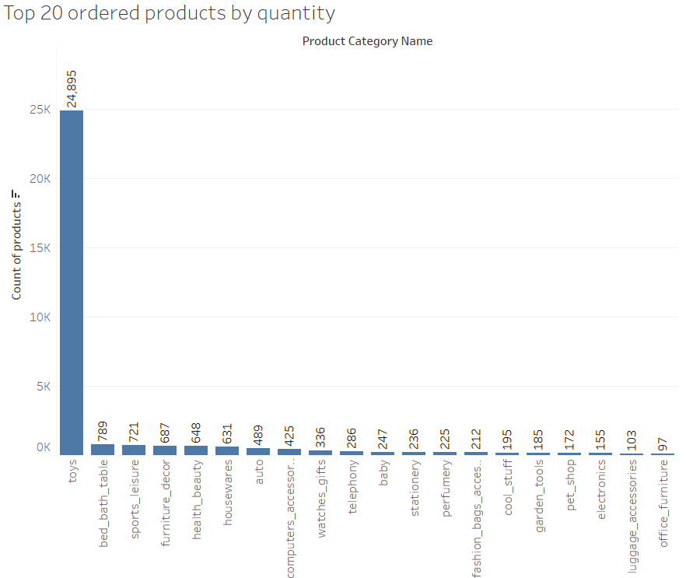

Slide 7
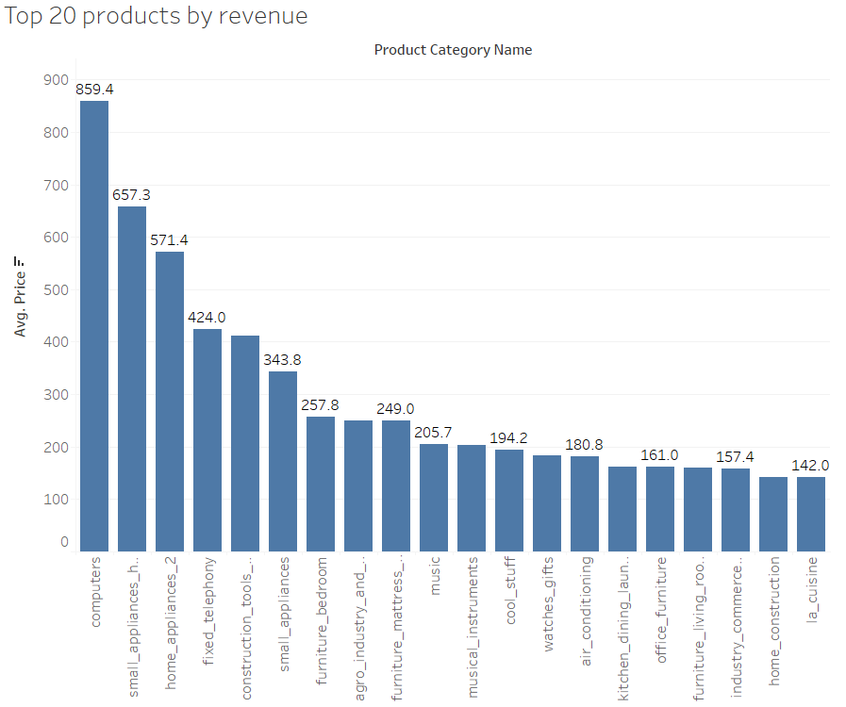

Slide 8
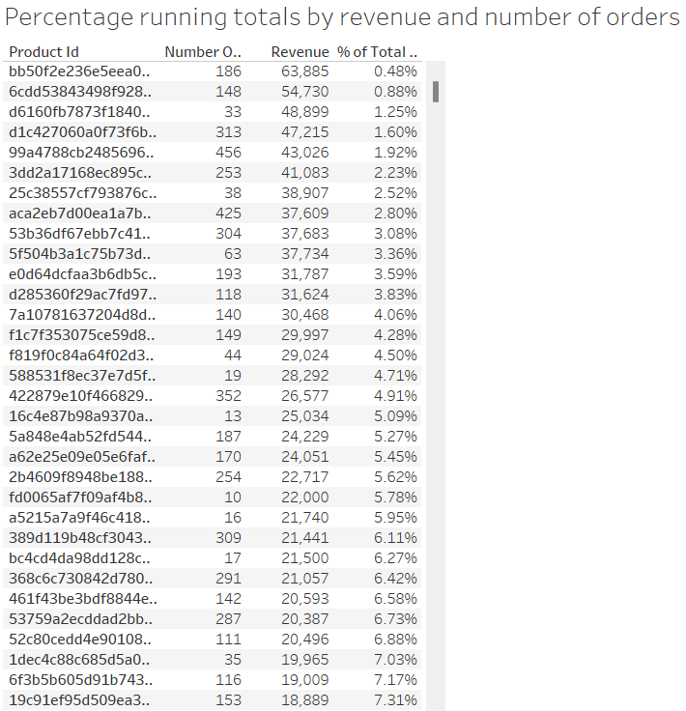

Slide 9
MARKET BASKET ANALYSIS Identified Combinations Of Categories Which Are Frequently Ordered Together.

Slide 10
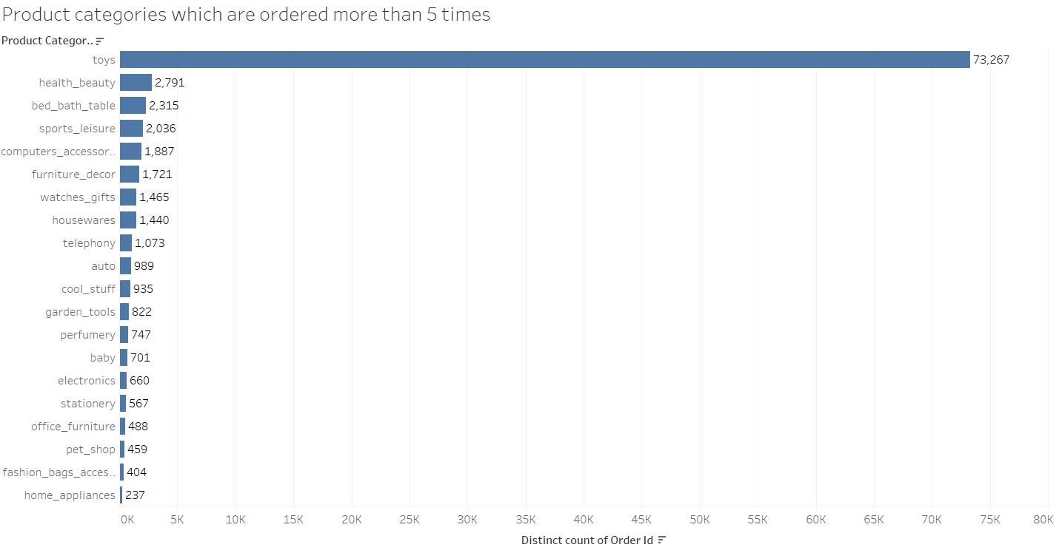

Slide 11
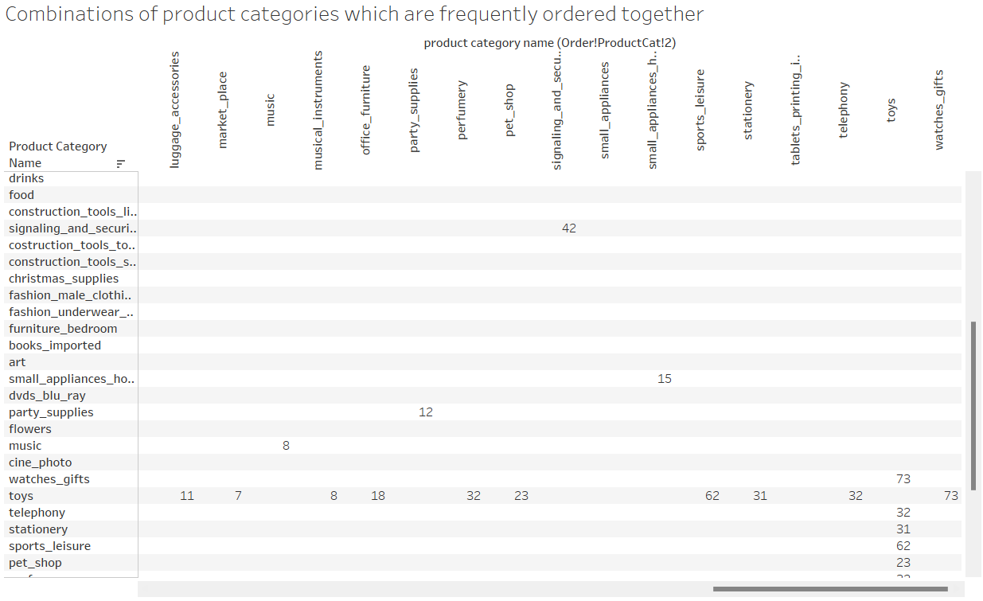

Slide 12
INFERENCES
The category ‘toys’ is the most ordered category as it is ordered 73267 times (76% of the total number of orders).
Apart from ‘toys’ , the categories ‘health_beauty’ , ’bed_bath_table’ , ’sports_leisure’ , ‘computers_accessories’ and ‘furniture_decor’ are the most frequently ordered categories . The above categories with ‘toys’ or/and with each other are most frequent in customers’ basket.
It is observed that despite of the high price , some products are frequently purchased by the customers.

Slide 13
RECOMMENDATIONS
Target customers who have children to boost up sales as they are most likely to purchase ‘toys’ which is the most ordered category.
Offer Promo-codes or discounts on frequently ordered category associations and the most ordered products to attract more customers.
Consider the ideal category depth to minimize the inventory cost by getting rid of the products which are seldom ordered and/or do not have a significant contribution to the total revenue under each product category.

Slide 14
THANK YOU

